Slide 1
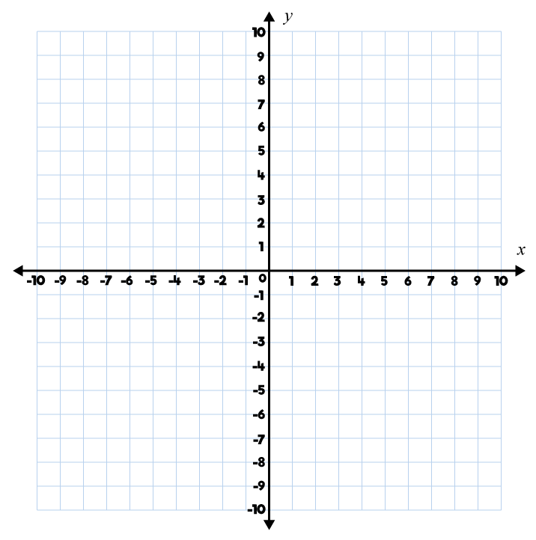
Year 5 | Week 1 | Day 1

Slide 2
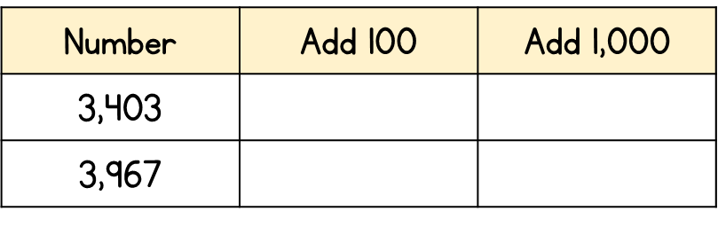
Year 5 | Week 1 | Day 2

Slide 3
Year 5 | Week 1 | Day 3

Slide 4
Year 5 | Week 1 | Day 4

Slide 5
Year 5 | Week 1 | Day 5

Slide 6
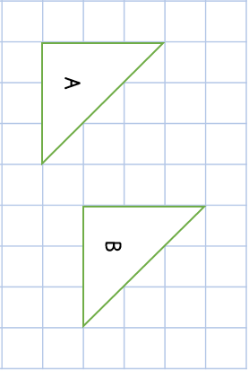
Year 5 | Week 2 | Day 1

Slide 7
Year 5 | Week 2 | Day 2

Slide 8
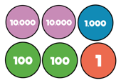
Year 5 | Week 2 | Day 3

Slide 9
Year 5 | Week 2 | Day 4

Slide 10
Year 5 | Week 2 | Day 5

Slide 11
Year 5 | Week 3 | Day 1

Slide 12
Year 5 | Week 3 | Day 2

Slide 13
Year 5 | Week 3 | Day 3

Slide 14
Year 5 | Week 3 | Day 4

Slide 15
Year 5 | Week 3 | Day 5

