Slide 1
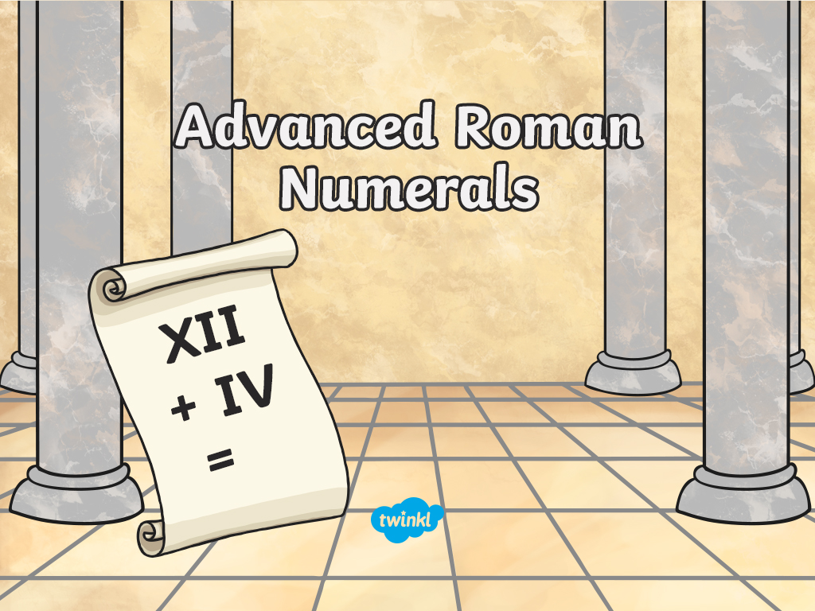

Slide 2
Aim
to know Roman numerals up to thousands.
Success Criteria

Slide 3
Roman Numerals
You should already know how to use these Roman numerals:
I V X
1
5
10

Slide 4
Roman Numerals
I = 1
V = 5
X = 10
Do you know these numbers?
VIII =
XIX =
XXIV =
8
19
24

Slide 5
So…What About Bigger Numbers?
We’ll need to introduce some new letters…
L
C
D
M
50
100
500
1000

Slide 6
How To Use Them
They work in just the same way as the smaller number letters.
L
C
D
M
50
100
500
1000
DL
XC
500 + 50 = 550
100 - 10 = 90
MM
DCIV
1000 + 1000 = 2000
DCIV 500 + 100 + (5 - 1) = 604
LXVII
MCC
50 + 10 + 5+ 1 + 1 = 67
1000 + 100 +100= 1200

Slide 7
Can you Remember What They All Mean?
I
V
X
1
5
10
L
C
D
M
50
100
500
1000

Slide 8
Work Out These Numbers…
DLVI
MCXV
556
1115
MCM
CDVIII
1900
408
MMCLIX
MDCLXVI
2159
1666

Slide 9
Work Out These Numbers…
L
C
D
M
50
100
500
1000
DLVI
MXCV
556
MCM
MXCV = 1095
CDVIII
1900
408
MMCLIX
MDCLXVI
2159
1666

Slide 10
Years
You’ll often find Roman numerals used to show years. Have a go at writing these years in Roman numerals.
1995
1945
MCMXCV
MCMXLV
2017
1450
MMXVII
MCDL
1066
1922
MLXVI
MCMXXII

Slide 11
Aim
to know Roman numerals up to thousands.
Success Criteria

Slide 12


