Slide 2
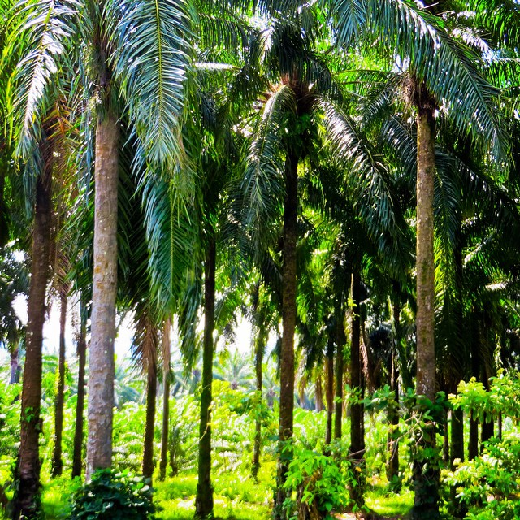
What Is Palm Oil?
Palm oil is a type of vegetable oil that is made from the fruit of oil palm trees. It has many different functions and properties, which means that it is a useful ingredient in lots of different products.
Two types of oil can be produced. This is done either by squeezing the stone in the middle of the fruit or the flesh around the outside of the stone.
Palm tree forest by kleinRN is licensed under CC BY 2.0

Slide 3
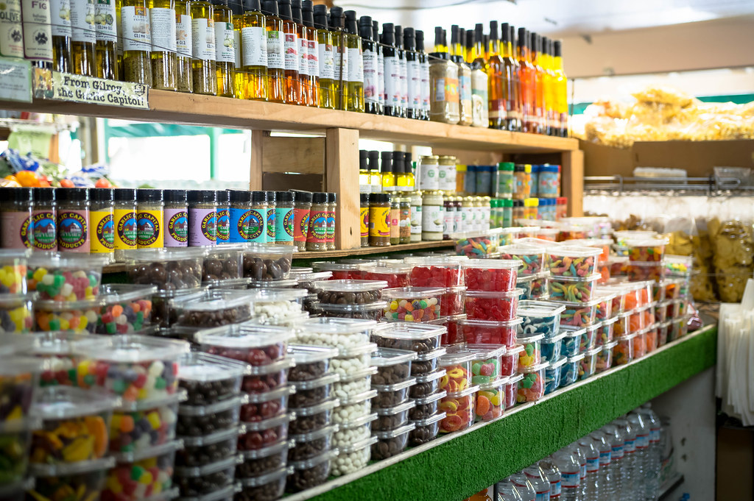
What Products Can It Be Found In?
Palm oil can be found in an incredible number and variety of products, from food to cosmetics.
It is estimated to appear in around half of all packaged products that we can find in the supermarket.
It can be found in types of frozen pizza, chocolate, bread and ice cream as well as lipstick, shampoo, soap, candles and detergent.
Market ile of candies and others by wuestenigel is licensed under CC BY 2.0

Slide 4
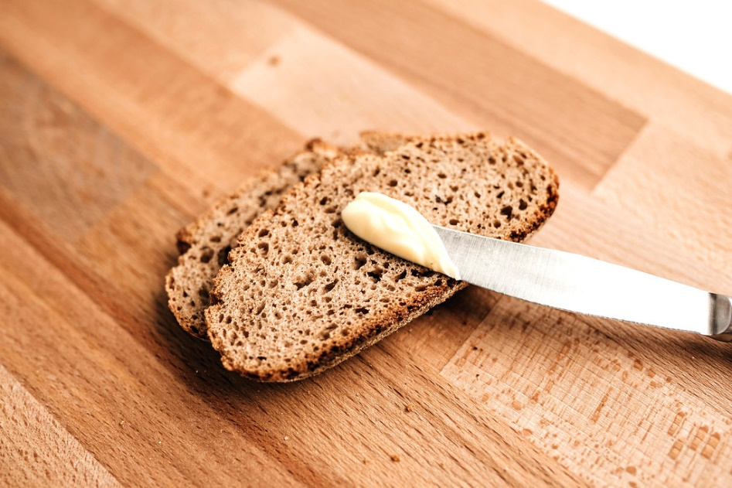
Why Is Palm Oil Useful?
It is useful to manufacturers because it stays semi-solid at room temperature, which means it can help to keep spreads like margarine spreadable.
It has other properties which help to make foods appear fresh or crisp for longer.
It has no colour or smell so it doesn’t change the product when added.
In addition, palm oil is used as a biofuel in some European countries, to replace fossil fuels such as coal, gas and diesel.
Rustikale Weizenbrotscheiben zum Frühstück by hmarco is licensed under CC BY 2.0

Slide 5
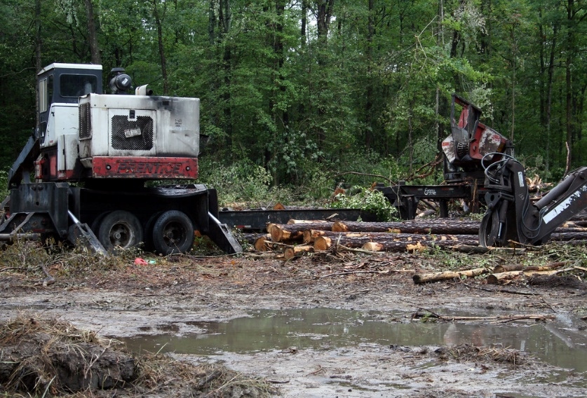
Why Is Using Palm Oil a Problem?
Oil palm trees are chopped down in order to take the fruit to make palm oil. These trees form the habitat for endangered species such as orangutans, elephants, tigers and rhinos. Every day, huge amounts of rainforest are bulldozed or burned to make way for new oil palm plantations.
By significantly reducing the number of trees in large forests, it is also contributing to climate change as it increases the amount of greenhouse gas in the atmosphere.
The production of palm oil has been increasing gradually for decades, making it a bigger problem now than ever.
Deforestation by utrophication&hypoxia is licensed under CC BY 2.0

Slide 6
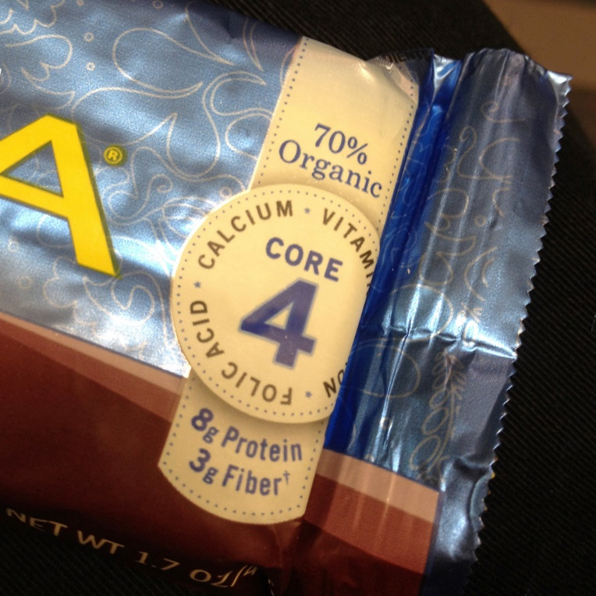
What Are Solutions to the
Palm Oil Problem?
Eating more home-cooked meals using alternative ingredients, rather than processed foods which contain palm oil
Reading product labels and aiming to buy those products which do not contain palm oil
Looking for the RSPO (Roundtable on Sustainable Palm Oil) logo which means that any palm oil used was produced in a responsible, certified way
Increasing our understanding and awareness of how palm oil is used and where it comes from
luna bars - 30 percent toxic? by woodleywonderworks is licensed under CC BY 2.0

Slide 7
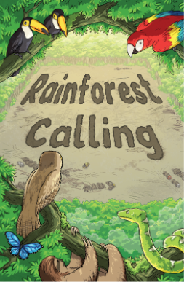
Further Reading: Rainforest Calling
In the Twinkl Originals eBook ‘Rainforest Calling’, the main character, Daisy, explores the rainforest via some webcams.
She encounters Pedro the potoo, whose rainforest habitat is under threat.
Read the story to see what she finds out about the rainforest, where deforestation is an ongoing problem.

Slide 8
Links for Further Reading
BBC Newsround
https://www.bbc.co.uk/newsround/39492207
World Wildlife Fund (WWF)
https://www.wwf.org.uk/updates/8-things-know-about-palm-oil
Rainforest Rescue
https://www.rainforest-rescue.org/topics/palm-oil
Greenpeace
https://www.greenpeace.org.uk/faqs-palm-oil-answered/
The Guardian
https://www.theguardian.com/news/2019/feb/19/palm-oil-ingredient-biscuits-shampoo-environmental

